Slide 1
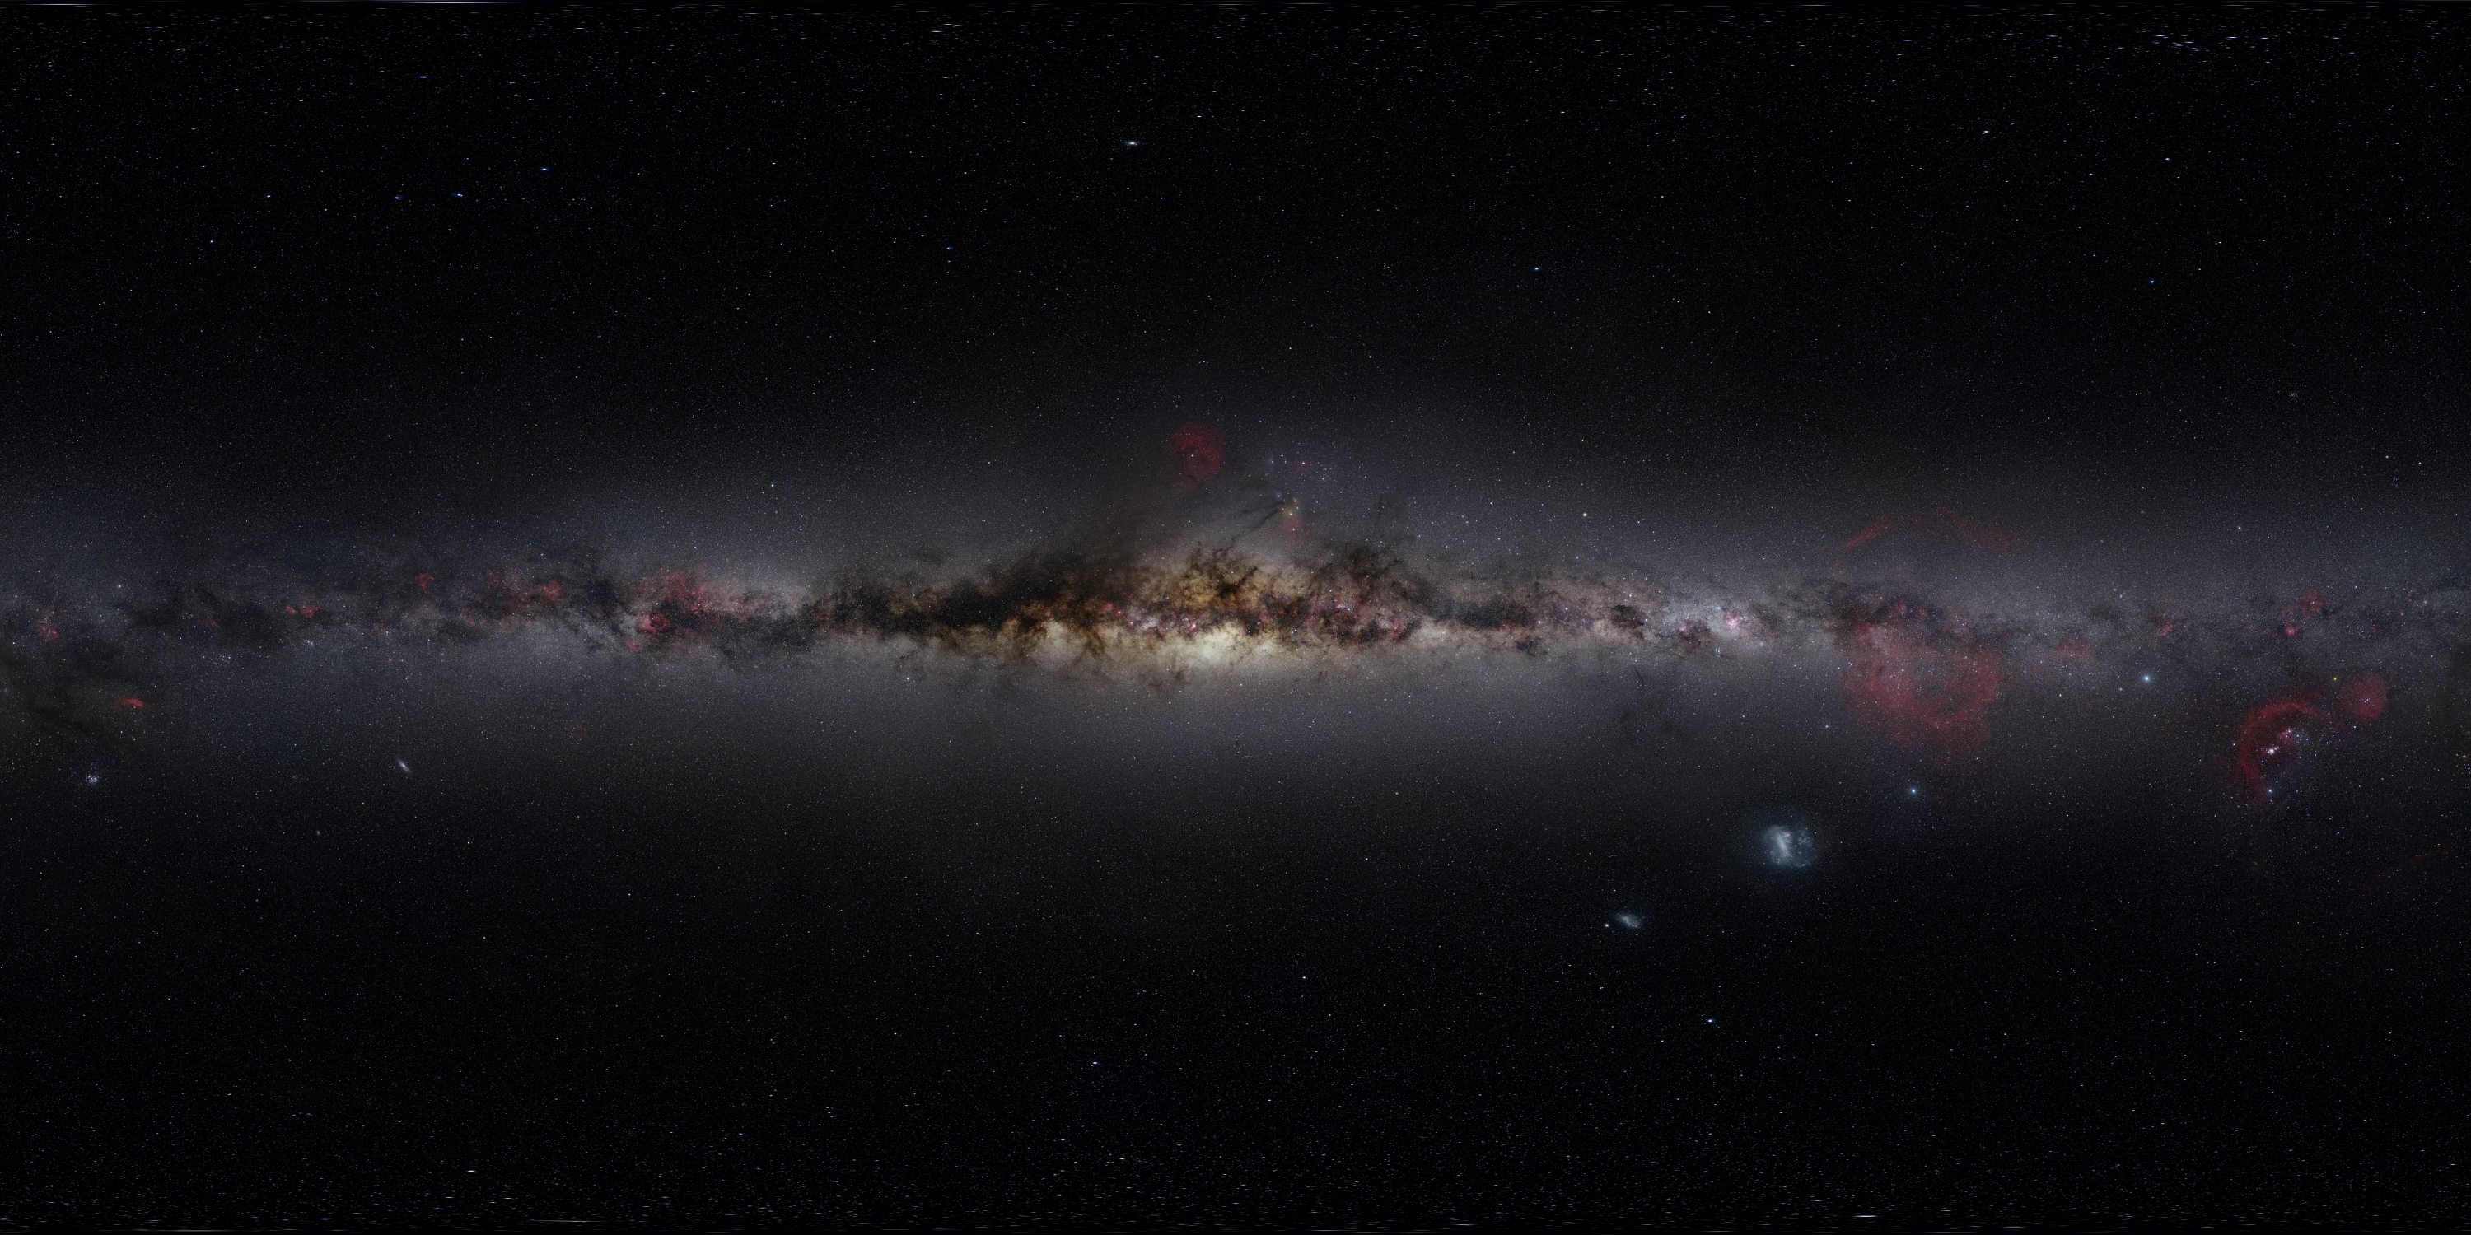



Unraveling non-standard physics through the global 21cm signal
Aryana Haghjoo¹,
Jonathan Sievers^{1,2}, Oscar Hernandez³
¹ McGill University, ² University of KwaZulu-Natal, ³ Marianopolis College

Slide 2


Outline
Introduction
Physical principals
Simulating the Global 21cm Signal
Non-Standard Effects
Observations of Global 21cm Signal
Parameter Estimation Methods
Levenberg-Marquardt
Markov Chain Monte-Carlo
Results
Test Curve
EDGES data

Slide 3
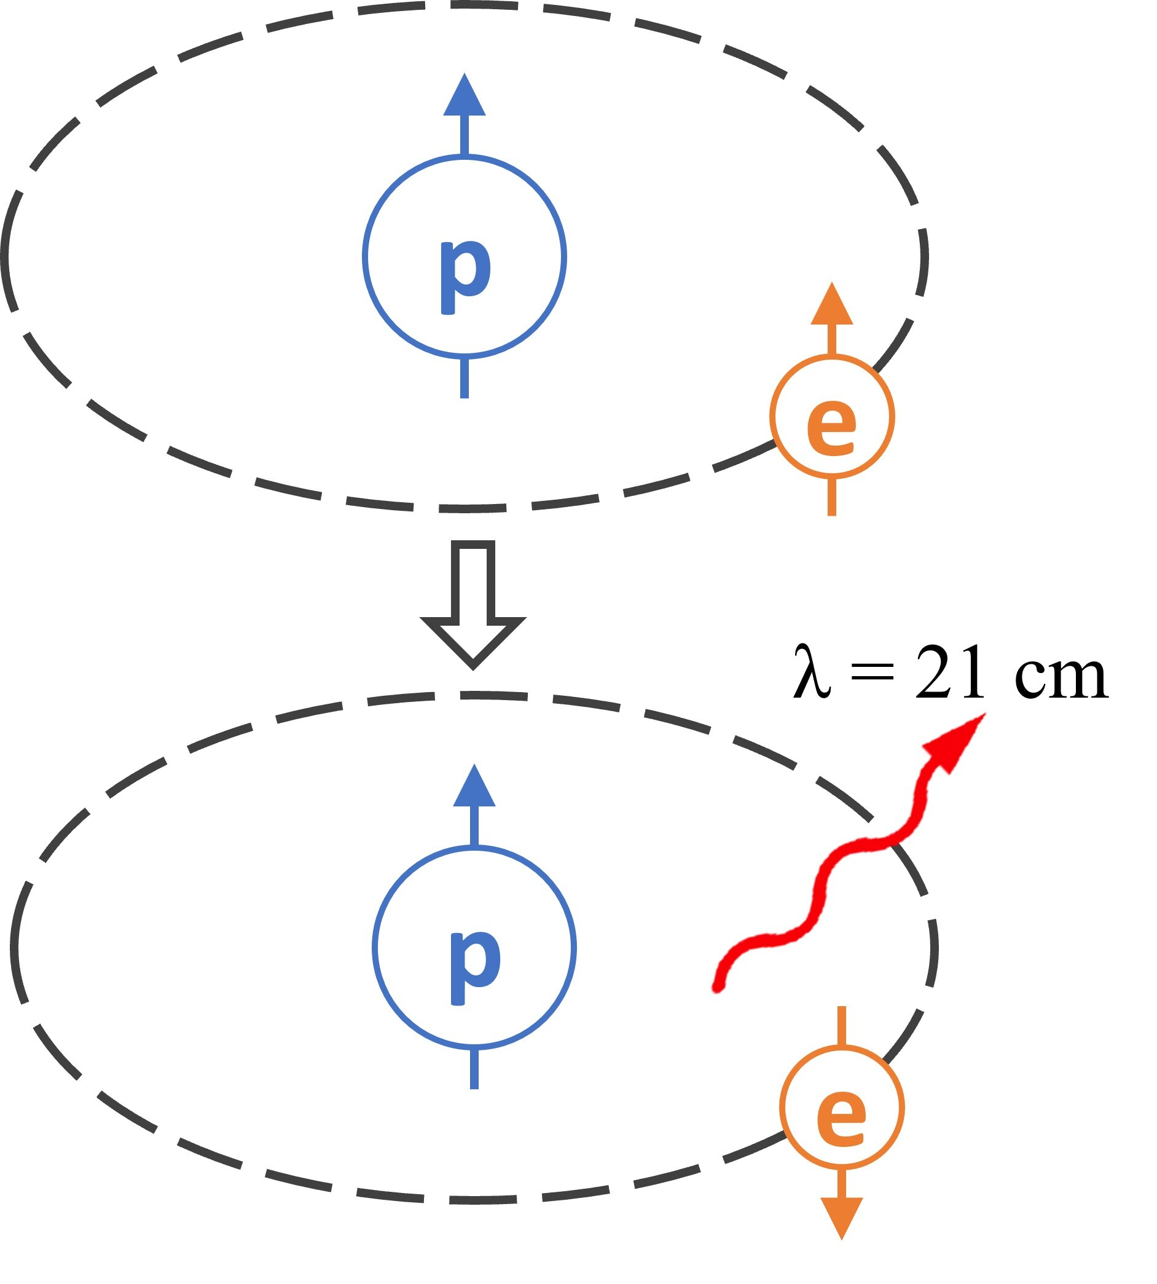
Theoretical Background
200<z<1100 (Dark Ages): Universe composed of hydrogen (75%), helium, small traces of heavy elements, free electrons, residual photons (CMB)
Neutral hydrogen: convenient tracer
Spin-flip transition on 1S ground state (ν = 1420.4057 MHz, and λ=21.1cm)
Kit Grodias
Notes:
Singlet and triplet state

Slide 4
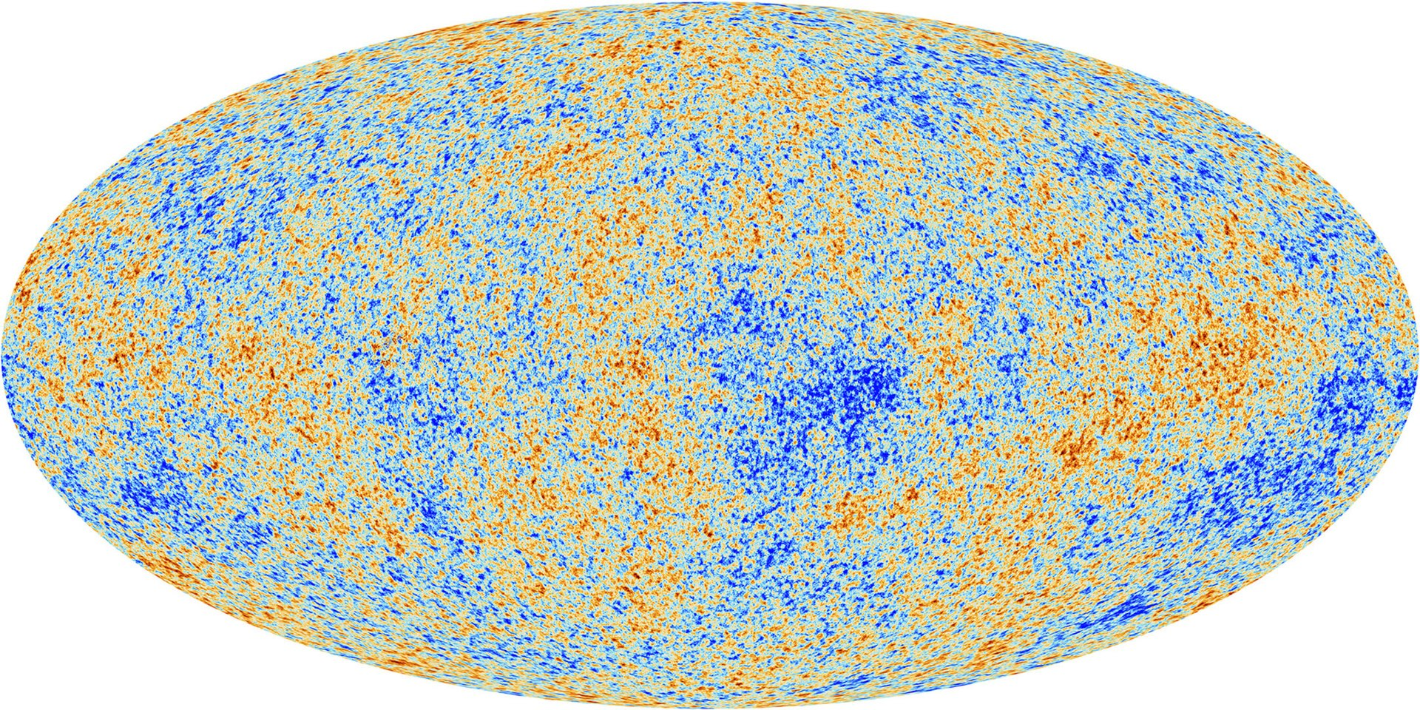
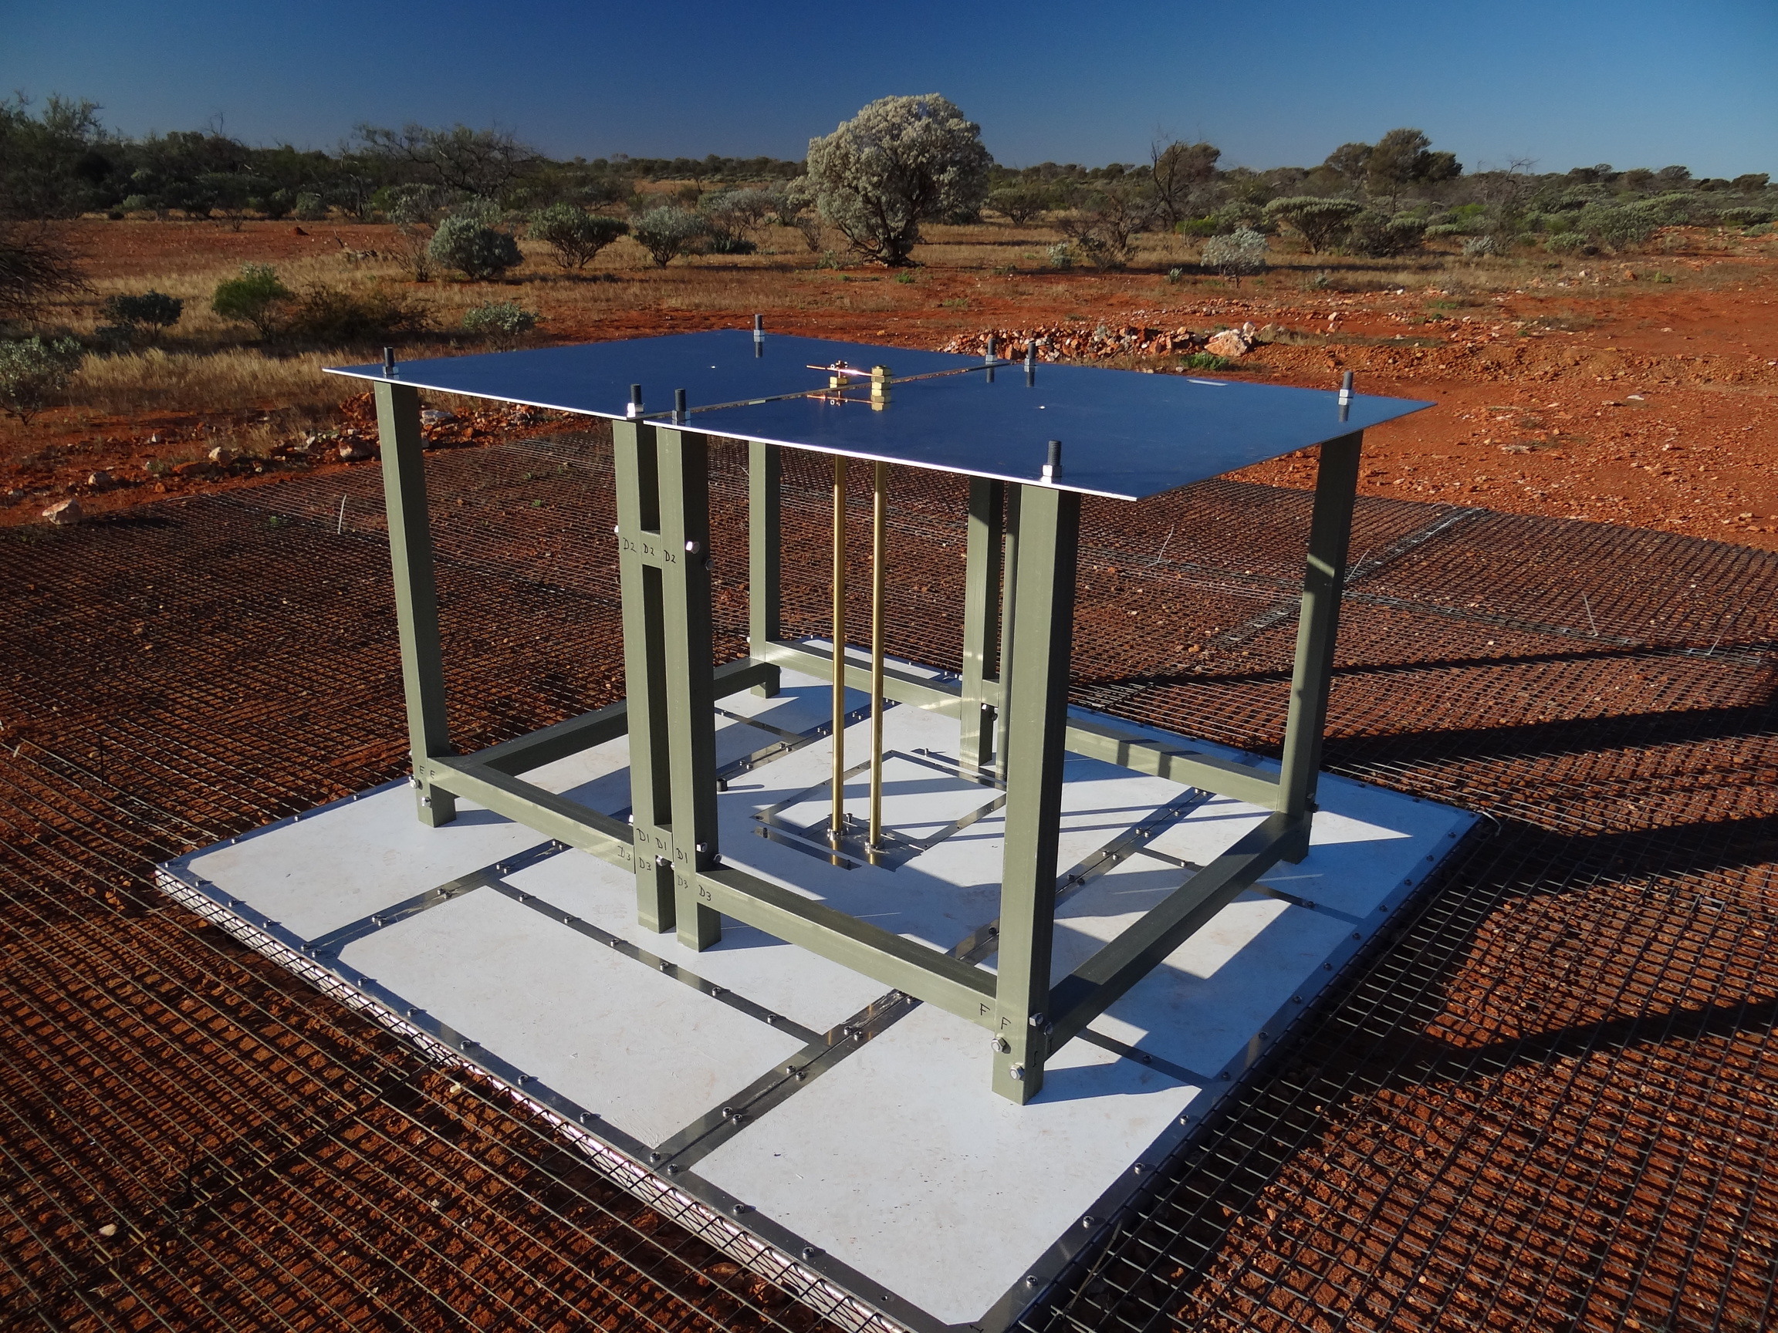
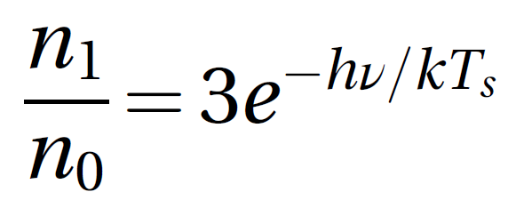
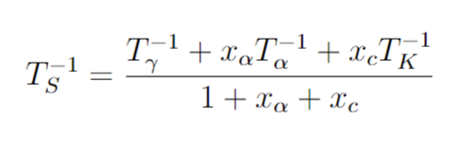
T_{γ}
T_{S}
T_{b}
T_{K}
x_{c} : collisional coupling coefficient
x_{α} : Lyα coupling coefficient
Notes:
Not all background is CMB!
Ignoring things other than CMB
Natue of T_s is not temperature
3: statistical weight (g_1/g_0)

Slide 5
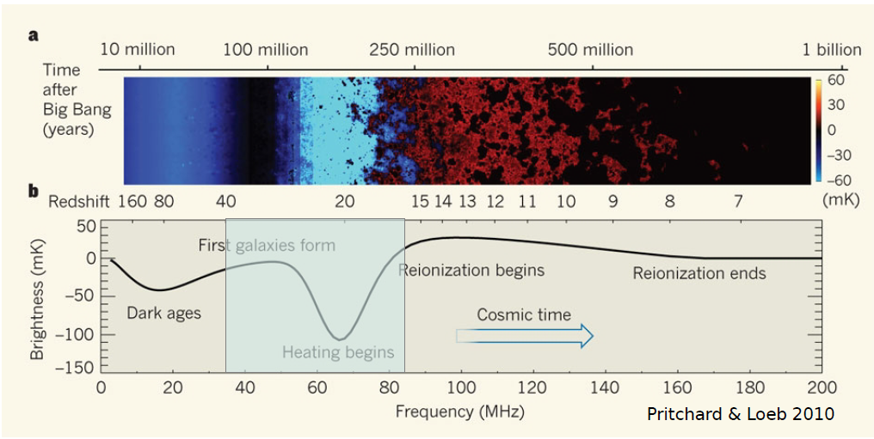
Global 21cm Signal
Average over the brightness temperature of the 21cm line
Presents as an excess absorption or emission (δT_{b} = Tγ - T_{S})
Coupling to Lyα background: Wouthuysen-Field effect/coupling
T_{S} → T_{K}
T_{S} → Tγ
Notes:
Studying global signal in the thermal history of universe
The top panel is a color plot showing fluctuations arising from variation in density
Redshift 7 till now; no 21cm signal
Imp: no exact constrain, uncertainty
Knowledge on early sources
High redshift region
21cm sensitive to T and d of H

Slide 6
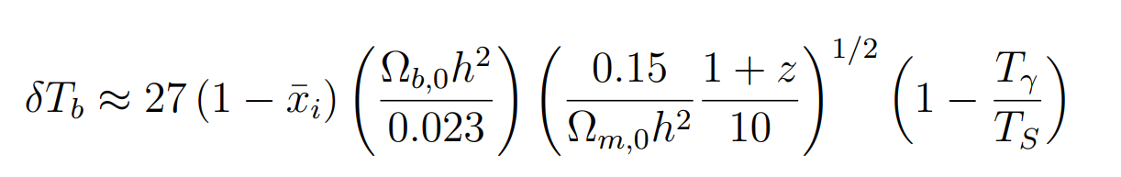
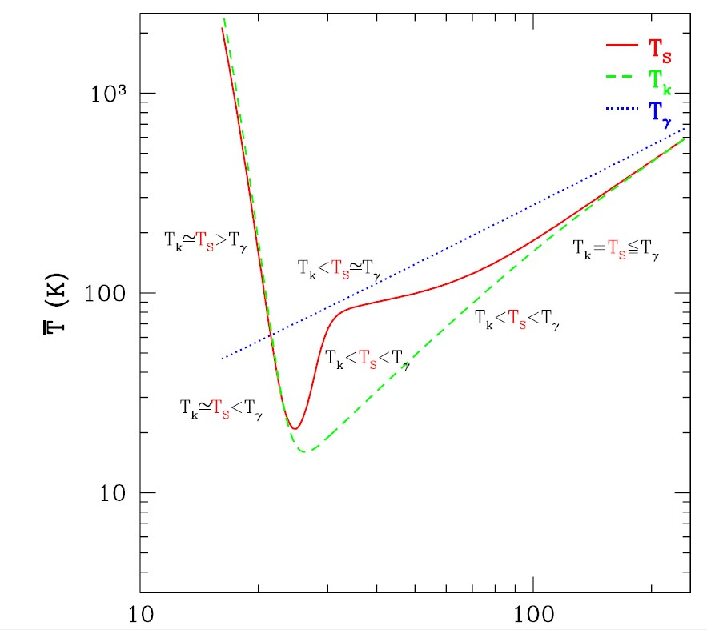
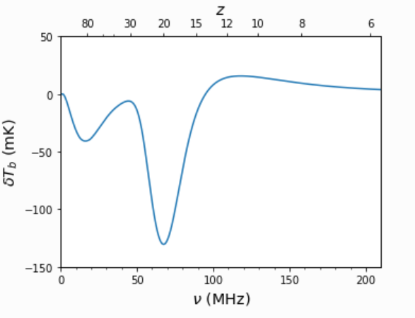
Simulating the Global 21cm Curve
Fully hydrodynamic simulations → semi–numerical
faster and more efficient
Simulators: 21cmFast, Accelerated Reionization Era Simulations (ARES)
Emulator: 21cmGEM, Radial Basis Function Interpolation (RBFI)
A. Mesinger et al, 2011
ARES documentation

Slide 7
Non-Standard Effects
(So you wanna see the non-standard physics? 😈)
Exotic Heating Mechanisms
How is the signal affected, assuming different non-standard scenarios?
Which non-standard effects demonstrate their signature in the global 21cm signal?
Dark matter models, certain particle interaction, cosmic string wakes
Notes:
Constraining the cosmic string wake theory
Keep this 2 times in mind!

Slide 8
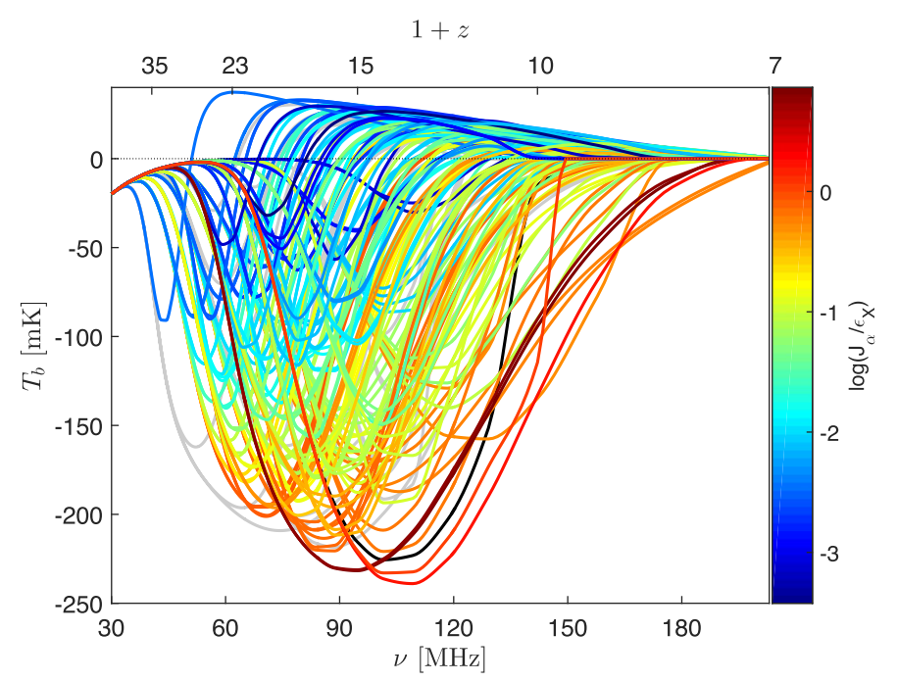
The 21-cm global signal as a function of redshift for 193 different astrophysical models
Cohen et al, 2017
Notes:
Parameter space of global 21cm signal in the standard theory

Slide 9

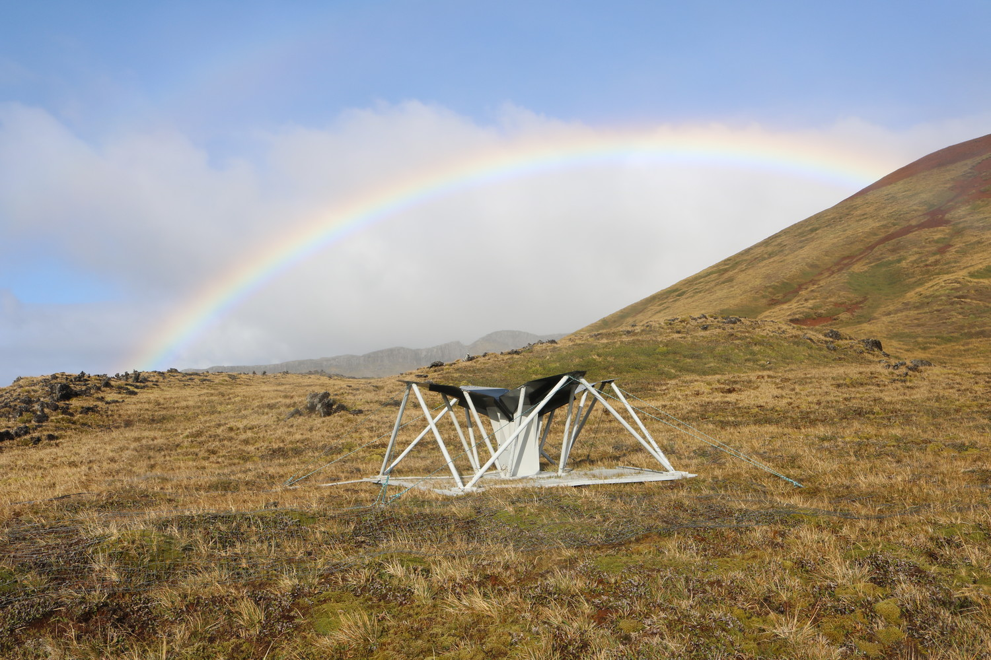
Observations of Global 21cm Signal
EDGES (Experiment to Detect the Global EoR Signature)
SARAS (Small Array for Research in Astrophysics of the South)
PRIZM (Probing Radio Intensity at high-Z from Marion)
REACH (Radio Experiment for the Analysis of Cosmic Hydrogen)
BIGHORNS (Broadband Instrument for Global HydrOgen ReioNisation Signal)
Judd D. Bowman et al, 2017
S. Singh et al, 2018
L. Philip et al, 2019
Notes:
A lot of experiments on 21cm, only a few on global 21cm
Foreground removal
Moon experiment

Slide 10
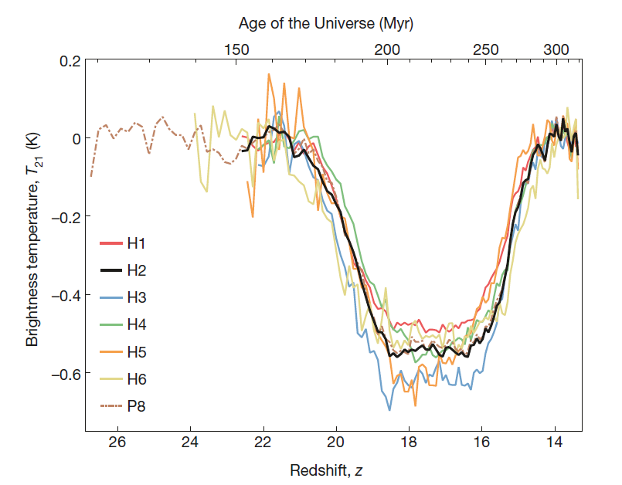
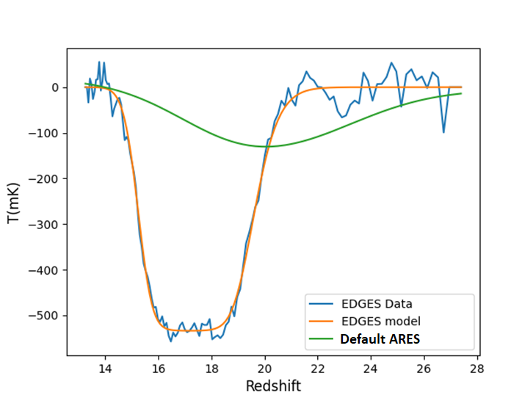
The EDGES Affair
Data released in 2017
Indicating that the gas temperature is cooler than what we expected
In contrast with SARAS results
Judd D. Bowman et al, 2017
Notes:
2 times

Slide 11
Parameter Estimation

Slide 12
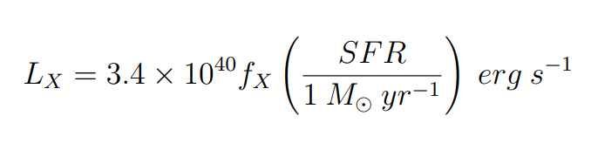
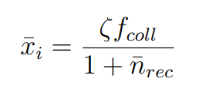
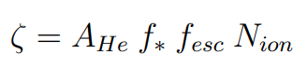
Parameter Estimation
Key Astrophysical Parameters
f_{X} : High-redshift normalization factor in the relation between X-ray luminosity and star formation rate (SFR)
N_{ion}: Mean number of ionizing photons produced per baryon of star formation (= pop_rad_yield_2)
f_{esc} : Fraction of ionizing photons that escape their host galaxy into the IGM
N_{lw}: Number of photons emitted in the Lyman-Werner band (11.2 − 13.6eV ) per baryon of star formation (= pop_rad_yield_0)
Ionizing fraction
Ionization efficiency
Notes:
Zeta: Ionizing efficiency
f_coll: collapse fraction (fraction of gas inside collapsed objects)
Uncertainty & thermal history of the intergalactic medium (IGM) and the population of x-ray sources during high-redshift epochs
d AHe = 4/(4 − 3Yp) = 1.22, where Yp is the mass fraction of helium, is a correction factor to convert the number of ionizing photons per baryon in stars to the fraction of ionized hydrogen
nrec is the mean number of recombinations per ionized hydrogen atom

Slide 13
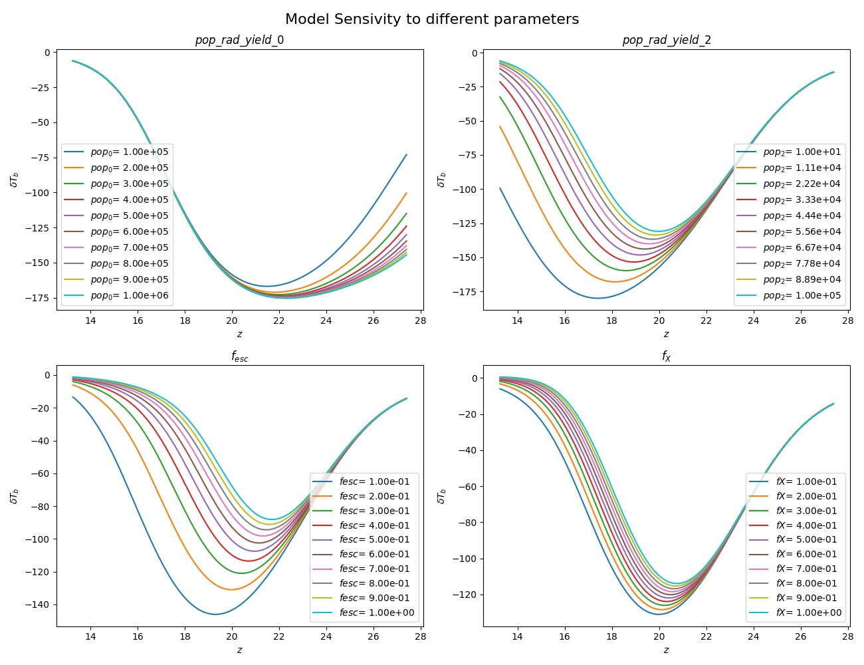

Slide 14
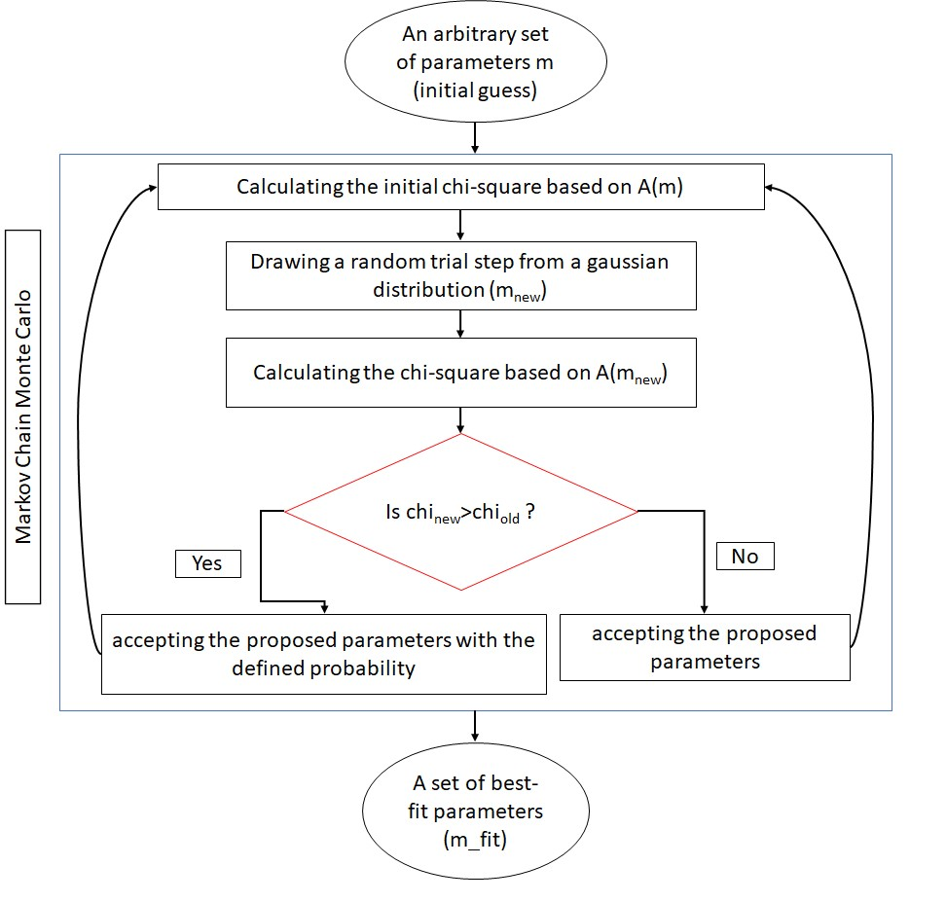
Markov Chain Monte-Carlo (MCMC)
14
Notes:
Iterative process!
Why do we choose MCMC? Why not ML or neural networks?

Slide 15
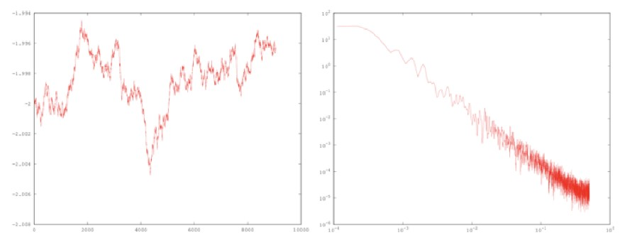
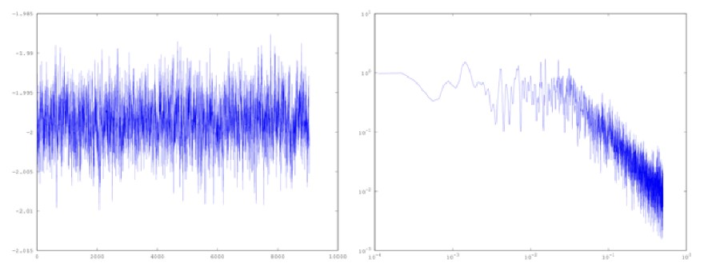
Convergence Test
MCMC chain
power spectrum
15
unconverged
converged
Jonathan Sievers
Notes:
Iterative process!

Slide 16
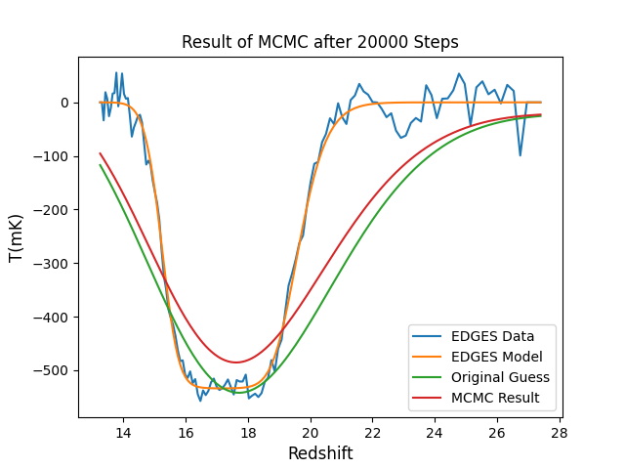
MCMC with ARES
A chain of 2E4 steps
~ 23 hours to produce this plot!
Still not yet fully converged!
Approximately 4 seconds for each ARES run

Slide 17
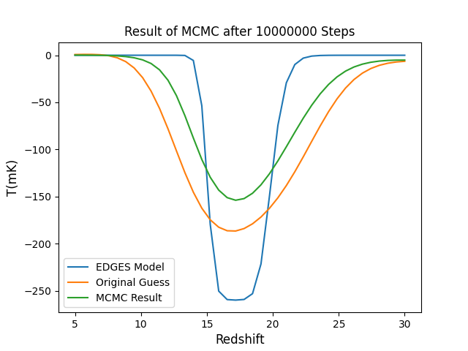
MCMC with RBFI
(Radial Basis Function Interpolation)
A chain of 1E7 steps
Runtime: ~ 22 hours
fully converged!
Half of the amplitude of the actual observed data
RBFI Credits: Hans Hopkins, Justin Cardona, Jared Tritt, Luc Bojorquez-Lopez

Slide 18
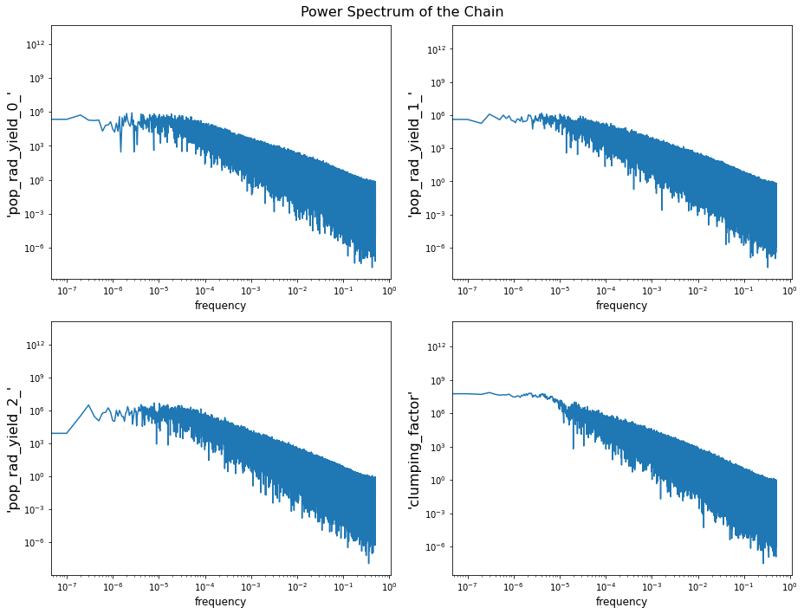
Convergence
Notes:
But we have used a lot of steps!

Slide 19
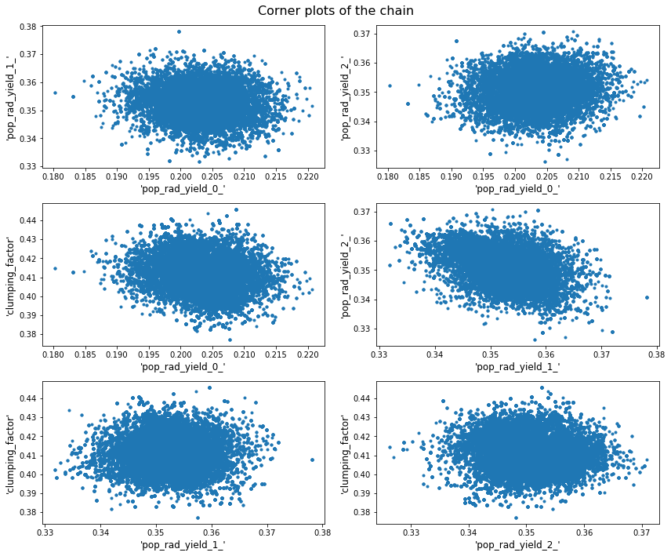
Corner Plots
Notes:
We expect MCMC chains to converge in 10^3 to 10^4 steps
Better to use the simulator rather than the emulator because of accuracy concerns
Helping the MCMC: posterior distribution: taking the correlation between the parameters into account
multivariant gaussian rather than individual Gaussians

Slide 20
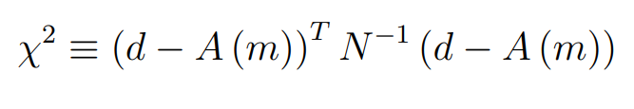
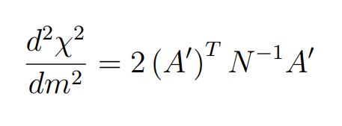
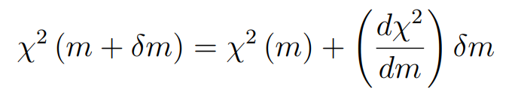
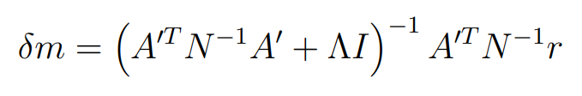
Levenberg – Marquardt (LM)
An iterative damped-least squares method
Will give us a reasonable starting point
More critical: The covariance matrix
We will draw samples from this covariance matrix and feed these samples to the MCMC
Curvature matrix
Notes:
Update the lambda on each iteration
Start with zero
If it gets worse (bigger chi-square): multiply the lambda with a factor
If it gets better (lower chi-square): divide the lambda with a factor

Slide 21
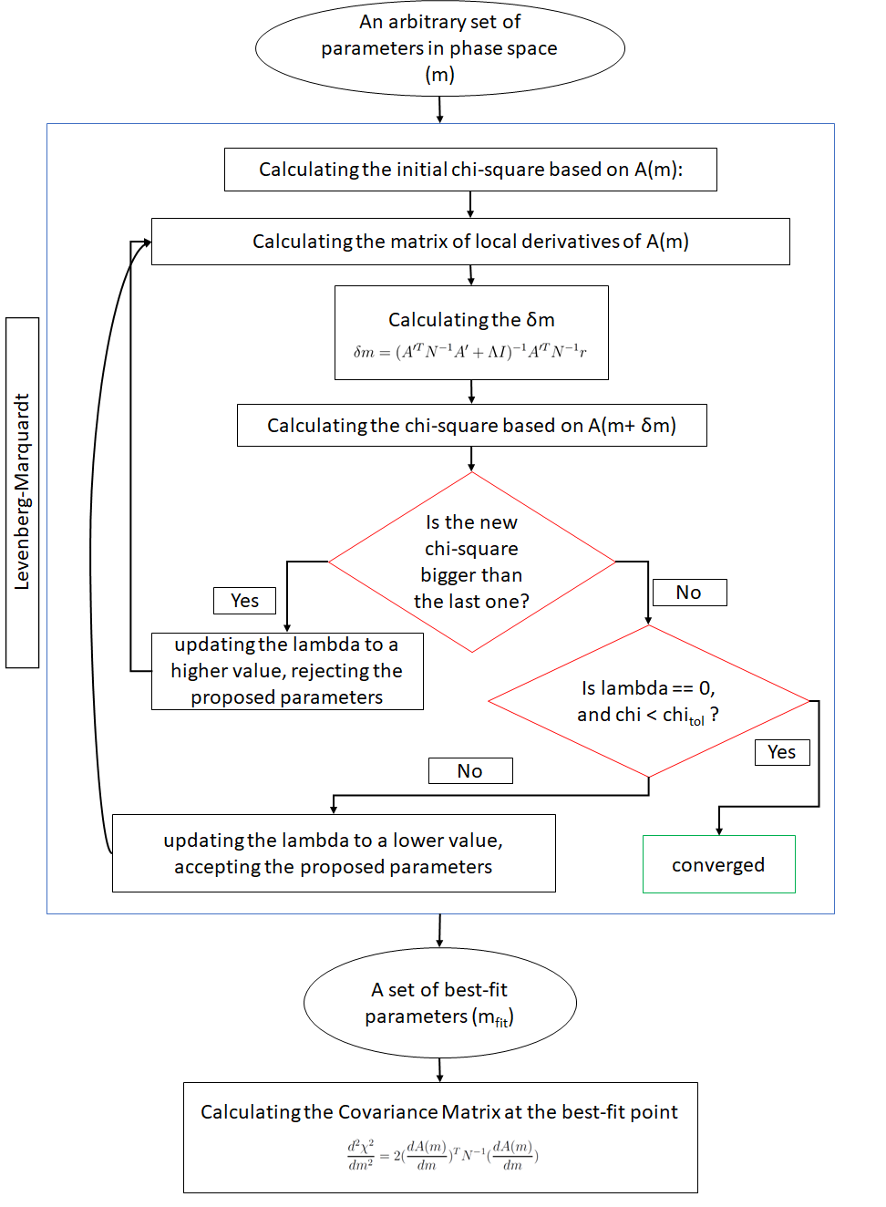
Notes:
Update the lambda on each iteration
Start with zero
Bigger lambda: punishing the algorithm for the path it chose

Slide 22
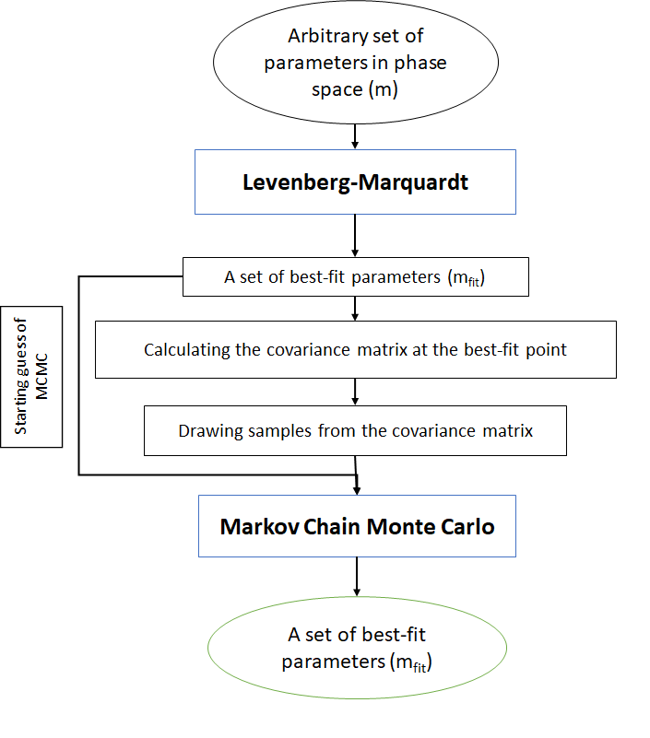
Combination of MCMC and LM

Slide 23
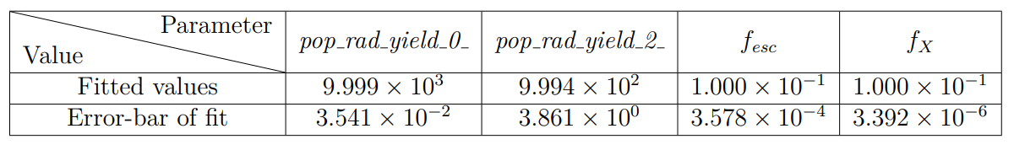
Results of Fit to EDGES data

Slide 24
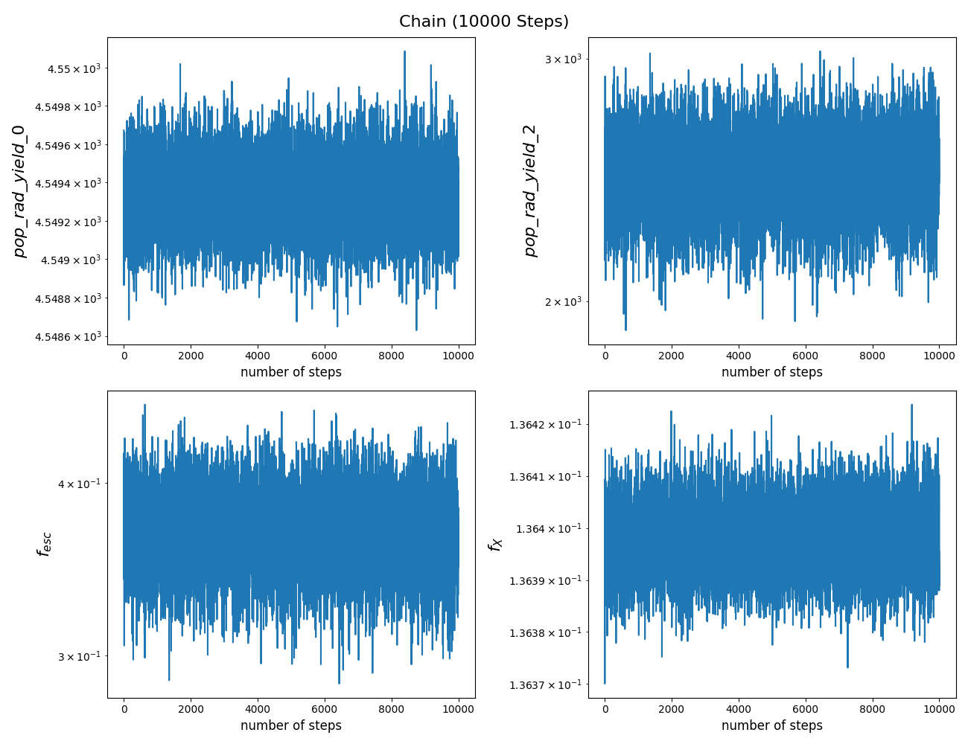
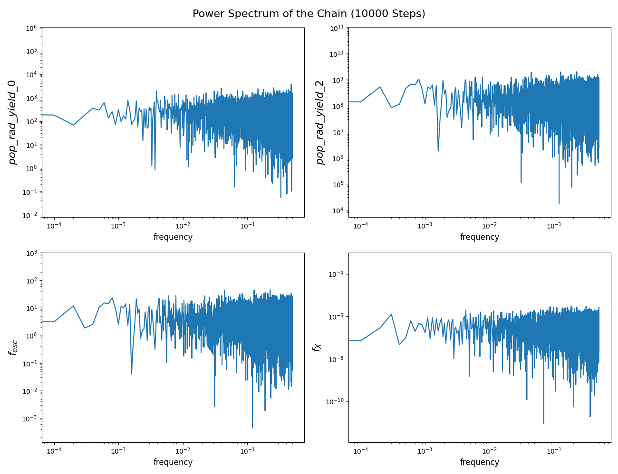

Slide 25
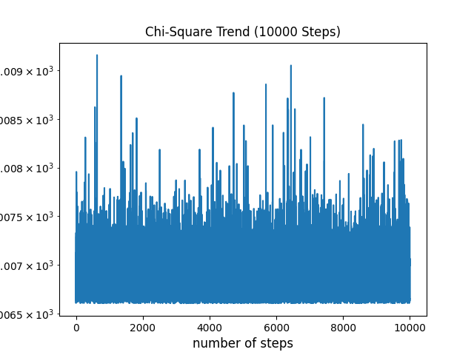

Slide 26
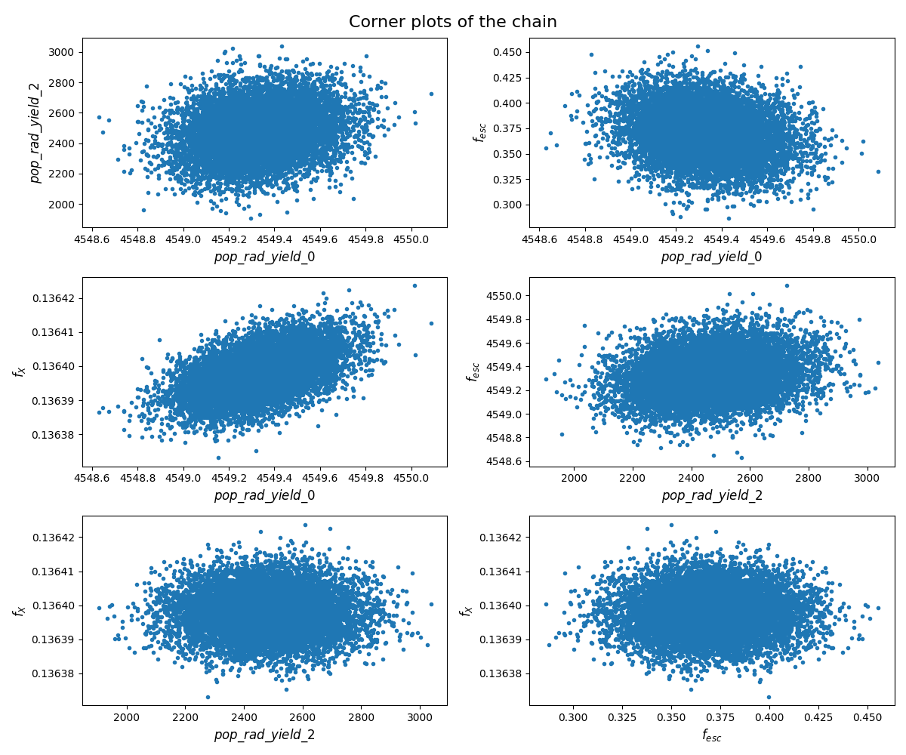

Slide 27
Future Perspective
Publishing our method as a Python package for parameters estimation of the global 21cm signal
Analyze the data from upcoming experiments
Updating ARES to include the desired non-standard effects
Investigate the difference in the behavior of specific astrophysical parameters in the presence of non-standard physics

Slide 28
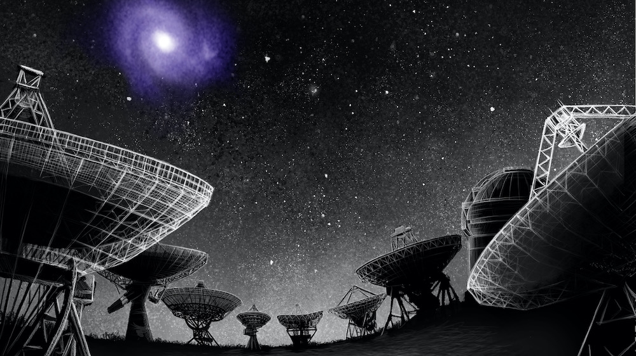
Thank You for Your Attention

